Slide 1

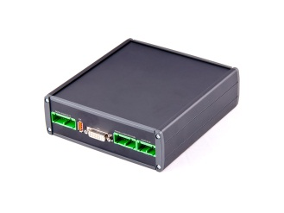
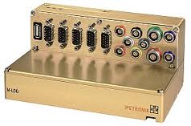
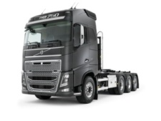
Standard equipment Field Test GOT
TEA2+ EU6 Trucks
VCN
Ultra
M-LOG
(External transducers &
other equipement)
(Video)
GPS
Audio
GPS
Driver triggerbutton
BB1
BB2
PTCan
EngSubnet
Diag
Chassi
Display
Safety2
Cab
Security
Infotainment
CAN subnets

Slide 2
Standard loggings Field Test GOT
TEA2+ EU6 Trucks
Tracking
GPS position, Odometer
Driver Error Reports
Complete CAN traffic 30s, Audio, (Video)
Triggered by button
Diagnostics
Area5, DTC, DM1, ECU-list
Standard Signal Loggings
About 150 CAN signals, recorded with 10Hz
Trigger: EngineSpeed > 300 rpm
Standard
Added measuerements
depending on truck
and users of data
Active Safety
Autotriggered by traffic conditions
Battery Loggings
I-SEE Loggings
ACM, Red Card Loggings
DM1 Autotriggered Loggings
......

